Slide 1
10.4 Complex Vector Spaces

Slide 2
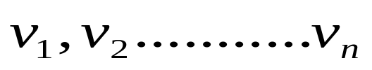
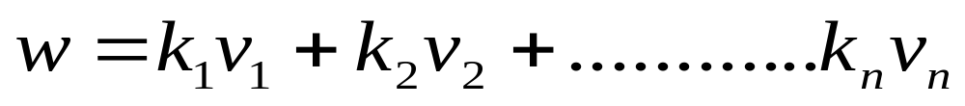

Basic Properties
Recall that a vector space in which the scalars are allowed to be complex numbers is called a complex vector space. Linear combinations of vectors in a complex vector space are defined exactly as in a real vector space except that the scalars are allowed to be complex numbers. More precisely, a vector w is called a linear combination of the vectors of , if w can be expressed in the form
Where are complex numbers.

Slide 3


Basic Properties(cont.)
The notions of linear independence, spanning, basis, dimension, and subspace carry over without change to complex vector spaces, and the theorems developed in Chapter 5 continue to hold with changed to .
Among the real vector spaces the most important one is , the space of n-tuples of real numbers, with addition and scalar multiplication performed coordinatewise. Among the complex vector spaces the most important one is , the space of n-tuples of complex numbers, with addition and scalar multiplication performed coordinatewise. A vector u in can be written either in vector notation

Slide 4
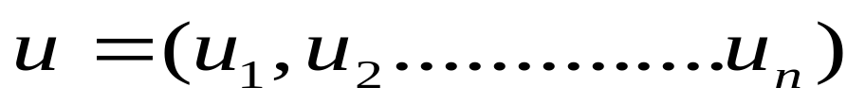
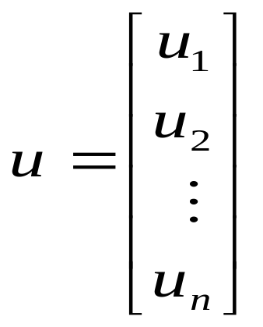
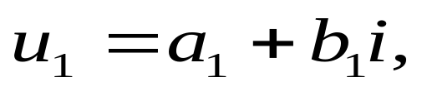
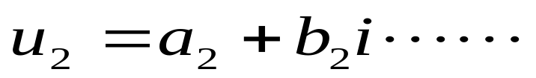
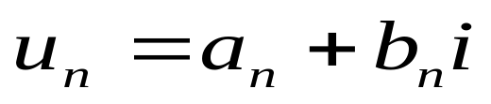
Basic Properties(cont.)
A vector u in can be written either in vector notation
Or in matrix notation
where

Slide 5
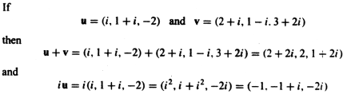
Example 1
  In as in , the vectors
  Form a basis. It is called the standard basis for . Since there are n vectors in this basis, is an n-dimensional vector space.

Slide 6
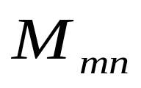
Example 2
In Example 3 of Section 5.1 we defined the vector space of m x n matrices with real entries. The complex analog of this space is the vector space of m x n matrices with complex entries and the operations of matrix addition and scalar multiplication. We refer to this space as complex .

Slide 7

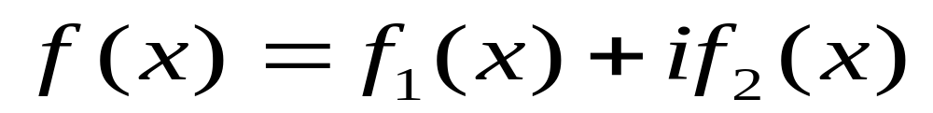
Example 3
If and are real-valued functions of the read variable x, then the expression
(1)
Is called a complex-valued function of the real variable x. Some examples are

Slide 8


Example 3(cont.)
Let V be the set of all complex-valued functions that are defined on the entire line. If and are two such functions and k is any complex number, then we define the sum function f+g and scalar multiple kf by

Slide 9


Example 3(cont.)
For example, if f=f(x) and g=g(x) are the functions in (1), then
It can be shown the V together with the stated operations is a complex vector space. It is the complex analog of the vector space of real-valued functions discussed in Example 4 of section 5.1.

Slide 10


Example 4
If is a complex-valued function of the real variable x, then f is said to the continuous if and are continuous. We leave it as a exercise to show that the set of all continuous complex-valued functions of a real variable x is a subspace of the vector space f all complex-valued functions of x. this space is the complex analog of the vector space discussed in Example 6 of Section 5.2 and is called complex . A closely related example is complex C[a,b], the vector space of all complex-valued functions that are continuous on the closed interval [a,b]

Slide 11


Recall that in the Euclidean inner product of two vectors
and
Was defined as
(2)
And the Euclidean norm (or length) of u as
(3)

Slide 12

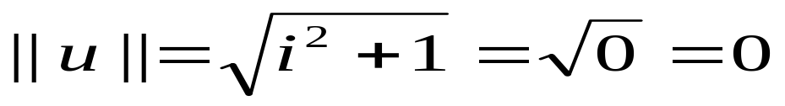
Unfortunately, these definitions are not appropriate for vectors in . For example, if (3) were applied to the vector u=(i, 1) in , we would obtain
So u would be a nonzero vector with zero length – a situation that is clearly unsatisfactory.
To extend the notions of norm, distance, and angle to properly, we must modify the inner product slightly.

Slide 13


Definition
and
If are vectors in , then their complex Euclidean inner product u‧v is defined by
Where are the conjugates
of

Slide 14

Example 5
The complex Euclidean inner product of vectors
is
Theorem 4.1.2 listed the four main properties of the Euclidean inner product on . The following theorem is the corresponding result for complex Euclidean inner procudt on .

Slide 15

Theorem 10.4.1
Properties of the Complex Inner Product
If u, v, and w are vectors in C^{n} , and k is any complex number, then :

Slide 16
Theorem 10.4.1(cont.)
Note the difference between part (a) of this theorem and part (a) of Theorem 4.1.2. We will prove parts (a) and (d) and leave the rest as exercises.
Proof (a).
and
Let then
and

Slide 17
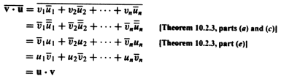
Theorem 10.4.1(cont.)
so

Slide 18
10.5 COMPLEX INNER PRODUCT SPACES
In this section we shall define inner products on complex vector spaces by using the propertied of the Euclidean inner product on C^{n} as axioms.

Slide 19
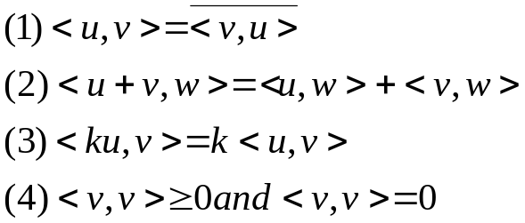
Unitary Spaces
Definition
  An inner product on a complex vector space V is a function that associates a complex number <u,v> with each pair of vectors u and v in V in such a way that the following axioms are satisfied for all vectors u, v, and w in V and all scalars k.

Slide 20
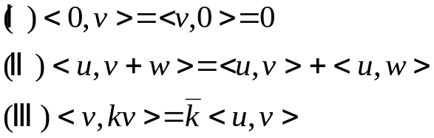

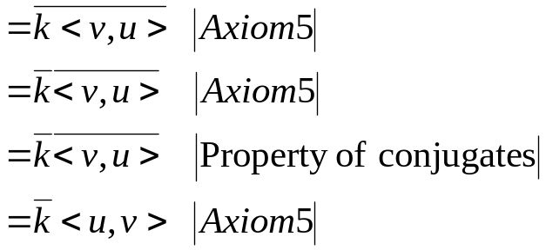
Unitary Spaces(cont.)
A complex vector space with an inner product is called a complex inner product space or a unitary space.

Slide 21

EXAMPLE 1 Inner product on C^{n}
Let u=(u₁,u₂,…, u_{n}) and v= (v₁,v₂,…,v_{n}) be vectors in C^{n}. The Euclidean inner product satisfies all the inner product axioms by Theorem 10.4.1.

Slide 22
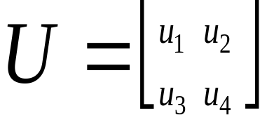
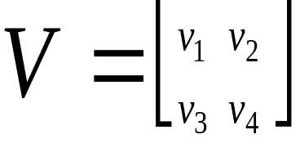

EXAMPLE 2 Inner Product on Complex M₂₂
If and
are any 2×2 matrices with complex entries, then the following formula defines a complex inner product on complex M₂₂ (verify)

Slide 23
EXAMPLE 3 Inner Product on Complex C[a,b]
If f(x)=f₁(x)+if₂(x) is a complex-valued function of the real variable x, and if f₁(x) and f₂(x) are continuous on [a,b], then we define

Slide 24
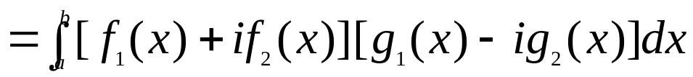
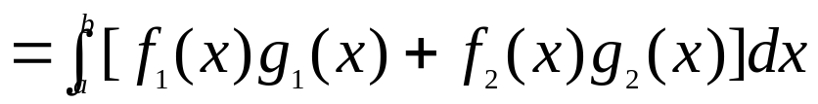
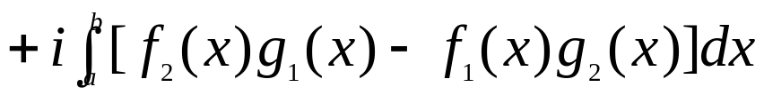
EXAMPLE 3 Inner Product on Complex C[a,b](cont.)
If the functions f=f₁(x)+if₂(x) and g=g₁(x)+ig₂(x) are vectors in complex C[a,b],then the following formula defines an inner product on complex C[a,b]:

Slide 25


EXAMPLE 3 Inner Product on Complex C[a,b](cont.)
In complex inner product spaces, as in real inner product spaces, the norm (or length) of a vector u is defined by and the distance between two vectors u and v is defined by
It can be shown that with these definitions Theorems 6.2.2 and 6.2.3 remain true in complex inner product spaces.

Slide 26
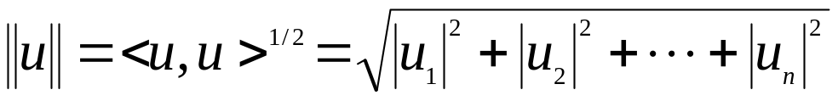

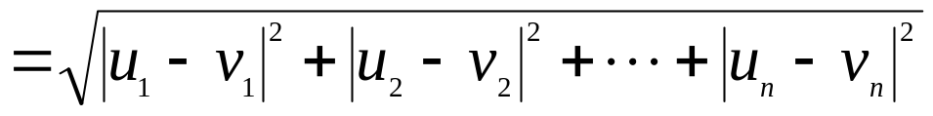
EXAMPLE 4 Norm and Distance in C^{n}
If u=(u₁,u₂,…, u_{n}) and v= (v₁,v₂,…,v_{n}) are vectors in C^{n} with the Euclidean inner product, then
and

Slide 27
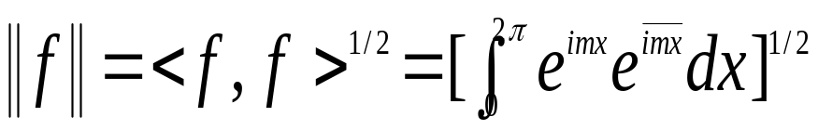
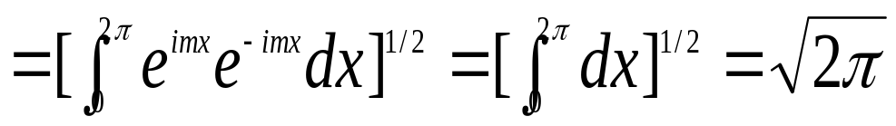
EXAMPLE 5 Norm of a function in Complex C[0,2π]
If complex C[0,2π] has the inner product of Example 3, and if f=e^{imx}, where m is any integer, then with the help of Formula(15) of Section10.3 we obtain

Slide 28
EXAMPLE 6 Orthogonal Vectors in C²
The vectors u = (i,1) and v = (1,i)
in C² are orthogonal with respect to the Euclidean inner product, since

Slide 29
EXAMPLE 7 Constructing an Orthonormal Basis for C³
Consider the vector space C³ with the Euclidean inner product. Apply the Gram-Schmidt process to transform the basis vectors u₁=(i,i,i),u₂=(0,i,i),u₃=(0,0,i) into an orthonormal basis.

Slide 30
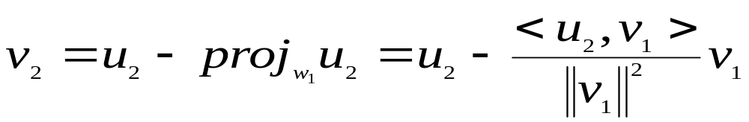
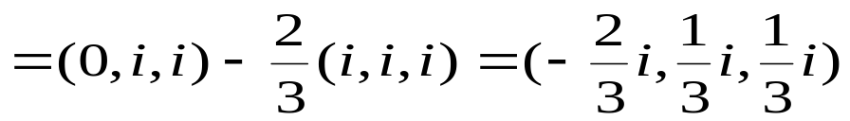
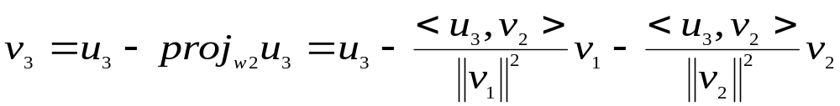
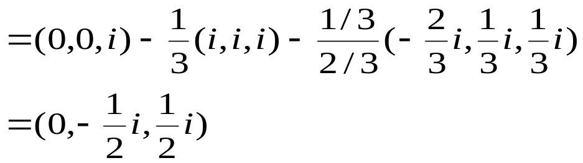
EXAMPLE 7 Constructing an Orthonormal Basis for C³(cont.)
Solution:
  Step1. v₁=u₁=(i,i,i)
  Step2.
  Step3.

Slide 31
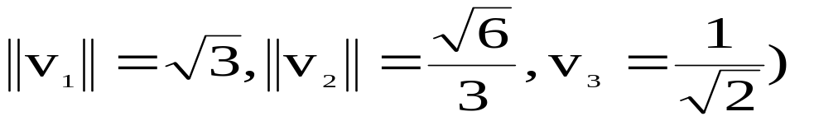
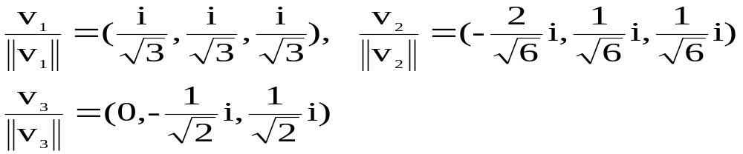
EXAMPLE 7 Constructing an Orthonormal Basis for C³(cont.)
Thus
form an orthogonal basis for C³.The norms of these vectors are
so an orthonormal basis for C³ is

Slide 32

EXAMPLE 8 Orthonormal Set in Complex C[0,2π]
Let complex C[0,2π] have the inner product of Example 3, and let W be the set of vectors in C[0,2π] of the form
where m is an integer.

Slide 33

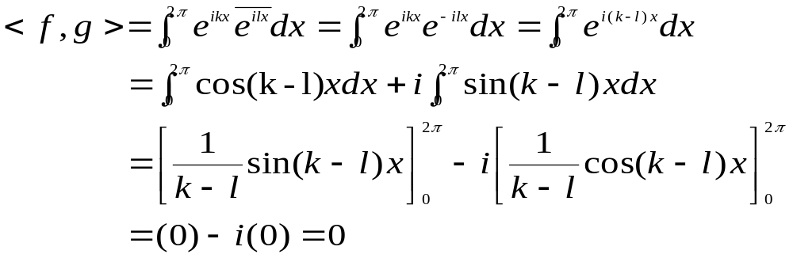
EXAMPLE 8 Orthonormal Set in Complex C[0,2π](cont.)
The set W is orthogonal because if
are distinct vectors in W, then

Slide 34
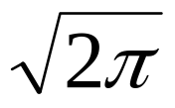
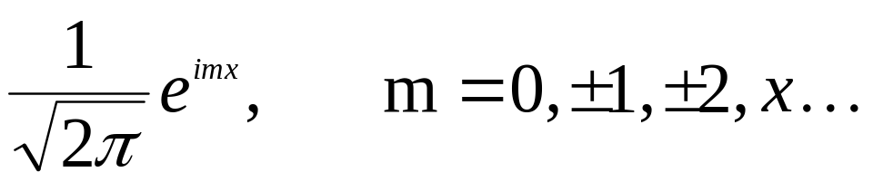
EXAMPLE 8 Orthonormal Set in Complex C[0,2π](cont.)
If we normalize each vector in the orthogonal set W, we obtain an orthonormal set. But in Example 5 we showed that each vector in W has norm , so the vectors
form an orthonormal set in complex C[0,2π]

Slide 35
10.6 Unitary, Normal, And Hermitian Matrices
For matrices with real entries, the orthogonal matrices(A⁻¹=A^{T}) and the symmetric matrices(A=A^{T}) played an important role in the orthogonal diagonal-ization problem(Section 7.3). For matrices with complex entries, the orthogonal and symmetric matrices are of relatively little importance; they are superseded by two new classes of matrices, the unitary and Hermitian matrices, which we shall discuss in this section.

Slide 36
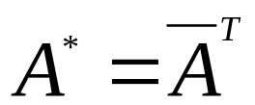


Unitary Matrices
If A is a matrix with complex entries, then the conjugate transpose of A, denoted by A*, is defined by
where is the matrix whose entries are the complex conjugates of the corresponding entries in A and is transpose of

Slide 37
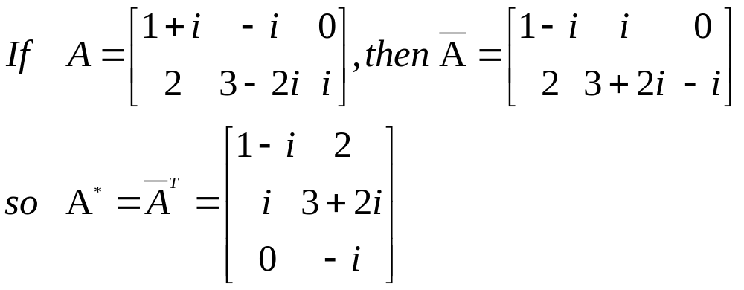
EXAMPLE1 Conjugate Transpose
The following theorem shows that the basic
properties of the conjugate transpose are
similar to those of the transpose.The proofs are
left as exercises.

Slide 38
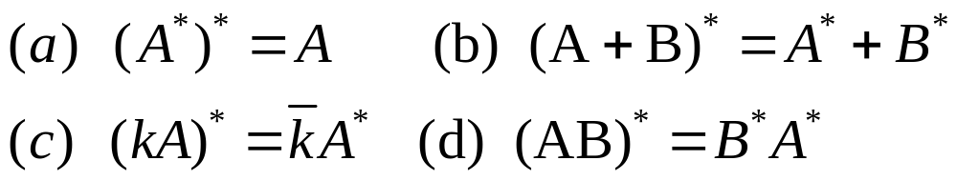

Theorem 10.6.1 Properties of the Conjugate Transpose
If A and B are matrices with complex entries and k is any complex number,then:
Definition
A square matrix A with complex entries is called unitary if

Slide 39
Theorem 10.6.2 Equivalent Statements
If A is an n × n matrix with complex entries, then the following are equivalent.
(a) A is unitary.
(b) The row vectors of A form an orthonormal set in C^{n} with the Euclidean inner product.
(c) The column vectors of A form an orthonormal set in C^{n} with the Euclidean inner product.

Slide 40
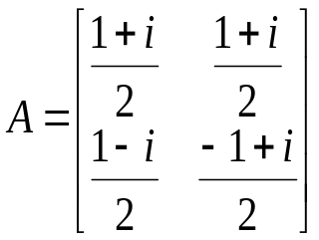
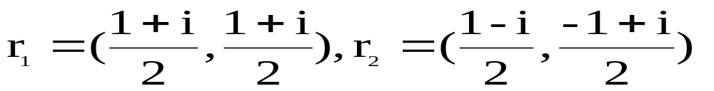
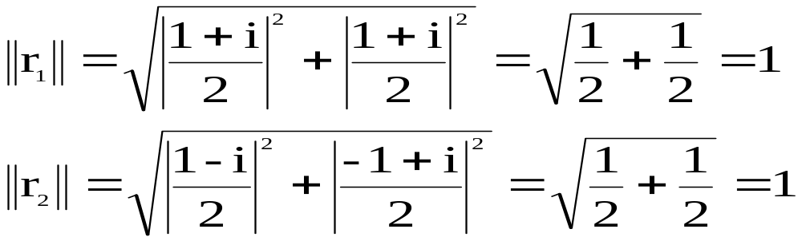
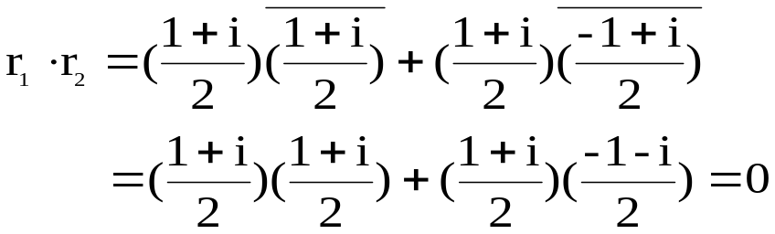
EXAMPLE2 a 2×2 Unitary Matrix
The matrix has row vectors

Slide 41
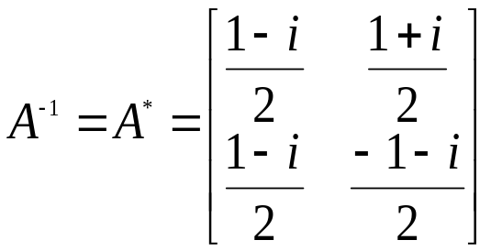
EXAMPLE2 a 2×2 Unitary Matrix(cont.)
So the row vectors form an orthonormal set in C².A is unitary and
A square matrix A with real entries is called orthogonally diagonalizable if there is an orthogonal matrix P such that P⁻¹AP(=P^{T}AP) is diagonal

Slide 42
Unitarily diagonalizable
A square matrix A with complex entries is called unitarily diagonalizable if there is a unitary P such that P⁻¹AP(=P*AP) is diagonal; the matrix P is said to unitarily diagonalize A.

Slide 43
Hermitian Matrices
The most natural complex analogs of the real symmetric matrices are the Hermitian matrices, which are defined as follows:
A square matrix A with complex entries is called Hermitian if A=A*

Slide 44
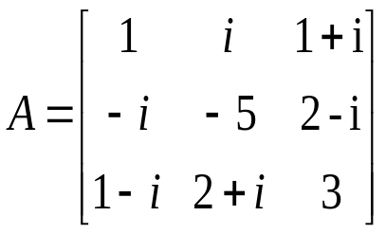
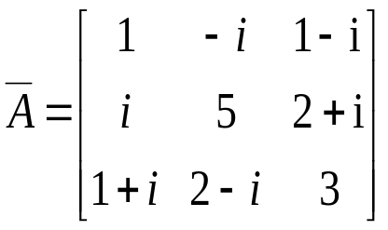
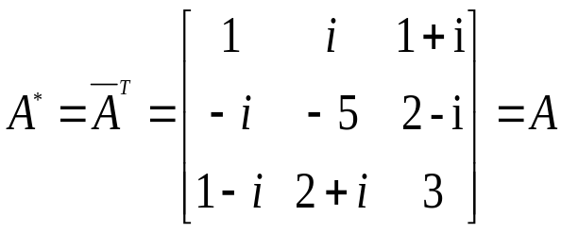
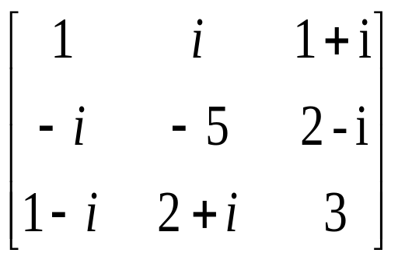
EXAMPLE 3 A 3×3 Hermitian Matrix
If then
so

Slide 45
Normal Matrices
Hermitian matrices enjoy many but not all of the properties of real symmetric matrices.
The Hermitian matrices do not constitute the entire class of unitarily diagonalizable matrices.
A square matrix A with complex entries is called normal if AA*= A*A

Slide 46
EXAMPLE 4 Hermitian and Unitary Matrices
Every Hermitian matrices A is normal since AA*=AA= A*A, and every unitary matrix A is normal since AA*=I= A*A.

Slide 47
Theorem 10.6.3 Equivalent Statements
If A is a square matrix with complex entries, then the following are equivalent:
(a) A is unitarily diagonalizable.
(b) A has an orthonormal set of n eigenvectors.
(c) A is normal.
A square matrix A with complex entries is unitarily diagonalizable if and only if it is normal.

Slide 48
Theorem 10.6.4
If A is a normal matrix, then eigenvectors from different eigenspaces of A are orthogonal.
The key to constructing a matrix that unitarily diagonalizes a normal matrix.

Slide 49
Diagonalization Procedure
Step 1. Find a basis for each eigenspace of A.
Step 2. Apply the Gram-Schmidt process to each of these bases to obtain an orthonormal basis for each eigenspace.
Step 3. Form the matrix P whose columns are the basis vectors constructed in Step 2. This matrix unitarily diagonalizes A.

Slide 50
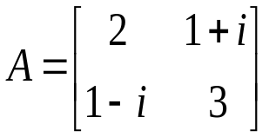
EXAMPLE 5 Unitary Diagonalization
The matrix is unitarily diagonalizable because it is Hermitian and therefore normal. Find a matrix P that unitarily diagonalizes A.

Slide 51
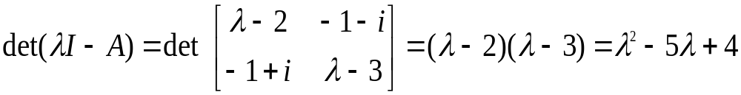
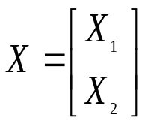
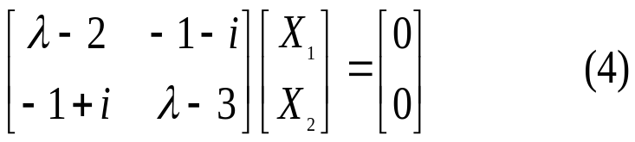
Solution
The characteristic polynomial of A is
so the characteristic equation is λ²-5λ+4 = (λ-1)(λ-4)=0 and the eigenvalues are λ=1 and λ=4. By definition, will be an eigenvector of A corresponding to λ if and only if x is a nontrivial solution of

Slide 52
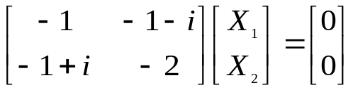


Solution(Cont.)
To find the eigenvectors corresponding to λ=1, Solving this system by Gauss-Jordan elimination yields(verify)
x₁=(-1-i)s, x₂=s
The eigenvectors of A corresponding to λ=1 are the nonzero vectors in C² of the form
This eigenspace is one-dimensional with basis

Slide 53



Solution(Cont.)
The Gran-Schmidt process involves only one step: normalizing this vector.
Since the vector
is an orthonormal basis for the eigenspace corresponding to λ=1.
To find the eigenvectors corresponding to λ=4

Slide 54



Solution(Cont.)
Solving this system by Gauss-Jordan elimination yields (verify)
so the eigenvectors of A corresponding to λ=4 are the nonzero vectors in C² of the form
The eigenspace is one-dimensional withbasis

Slide 55



Solution(Cont.)
Applying the Gram-Schmidt process
(i.e., normalizing this vector0 yields
diagonalizes A and

Slide 56
Theorem 10.6.5
The eigenvalues of a Hermitian matrix are real numbers.
Proof. If λ is an eigenvalue and v a corresponding eigenvector of an n × n Hermitian matrix A, then Av=λv
If we multiply each side of this equation on the left by v* and then use the remark following Theorem 10.6.1 to write v*v=||v||² (with the Euclidean inner product on C^{n}), then we obtain v*Av= v*(λv)= λ v*v= λ||v||²

Slide 57

Theorem 10.6.5(cont.)
But if we agree not to distinguish between the 1 × 1 matrix v*Av and its entry, and if we use the fact that eigenvectors are nonzero, then we can express λ as
To show that λ is a real number it suffices to show that the entry of v*Av is Hermitian, since we know that Hermitian matrices have real numbers on the main diagonal. (v*Av)*= v*A* (v*)*=v*Av
which shows that v*Av is Hermitian and completes the proof.

Slide 58
Theorem 10.6.6
The eigenvalues of a symmetric matrix with real entries are real numbers.

